Slide 1
Computer ARCHITECTURE (CA)
Course Instructor
Hira beenish
Department of Computer Science

Slide 2
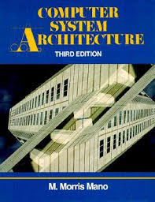
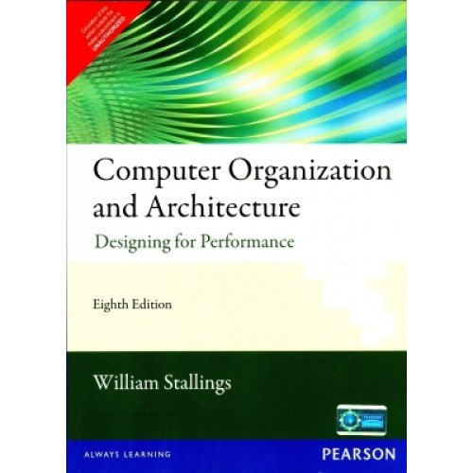
Recommended Books
Computer Systems Architecture, 3rd Edition
By M.Morris Mano; Prentice Hall International
Computer Organization and Architecture Designing For Performance By William Stallings

Slide 3
Chapters Included
1. Digital logic circuits
2. Digital components
3. Data Representation
4. Register transfer
5. Basic Computer Organization & Design →→Mid Term
6. Central processing unit
7.Pilpeline & vector processing
8. Computer arithmetic
9. I/O & O/P organization
10. Memory organization
11. Multiprocessors

Slide 4
Chapter#2 Digital Components

Slide 5
Contents
Integrated circuits
Decoders
Multiplexers
Registers
Shift registers
Binary counters
Memory units

Slide 6
Digital components
Integrated circuits
Digital circuits are constructed with integrated circuits
It's a neat way of cramming hundreds, thousands, millions, or even billions of electronic components onto tiny chips of silicon no bigger than a fingernail. let's take a closer look at ICs and how they work!
As the technology of Ics has improved, the number of gates that can be put in a single chip has increased considerably.
The differentiation between those chips that have a few internal gates & those having hundreds or thousands of gates is made by a customary reference to a package being either a small, medium or large scale integration device. i.e
SSL, MSI, LSI, & VLSI

Slide 7
Integrated circuits
Small-scale integration (SSI) devices contain several independent gates in a single package. the number of gates is usually less than 1, limited by the number of pins available in the IC.
Medium-scale integration (MSI) devices have a complexity of approximately 10 to 200 gates in a single package. They usually perform specific elementary digital functions such as decoders, adders, and registers.
Large -scale integration (LSI) devices contain between 200 and a few thousand gates in a single package. They include digital systems, such as proces­sors , memory chips, and programmable modules.
Very-large-scale integration (VLSI) devices contain thousands of gates within a single package. Examples are large memory array and complex microcomputer chips. Because of their small size and low cost, VLSI devices have revolutionized the computer system design technology

Slide 8
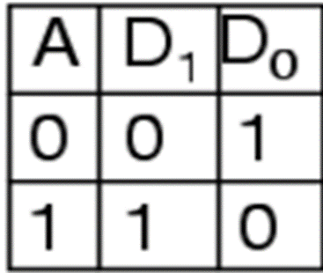
decoders
A decoder is a combinational circuit that converts binary information from the n code input to maximum of 2 coded output
In its general form, a decoder has n input lines to handle n bits and from one to 2n output lines to indicate the presence of one or more n-bit combinations.
The simplest is the 1-to-2 line decoder. The truth table is
Only more is the 2-to-4 line decoder. The truth table is

Slide 9

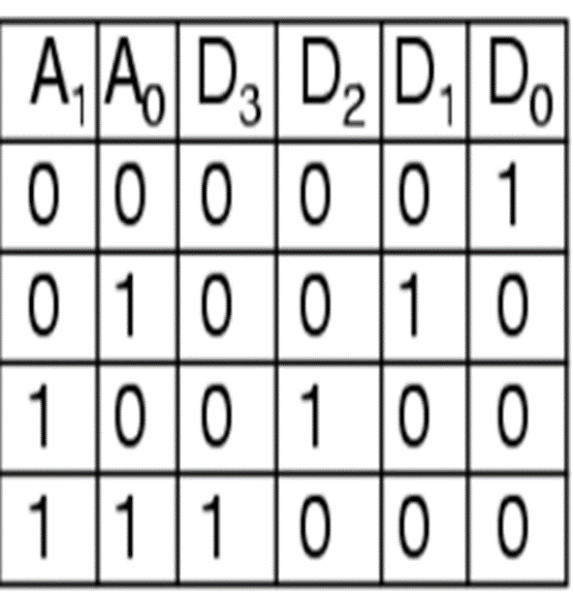
The Basic Binary Decoder
In a similar fashion
A 3-to-8 line decoder can be made
4-to-16 line decoder can be made

Slide 10
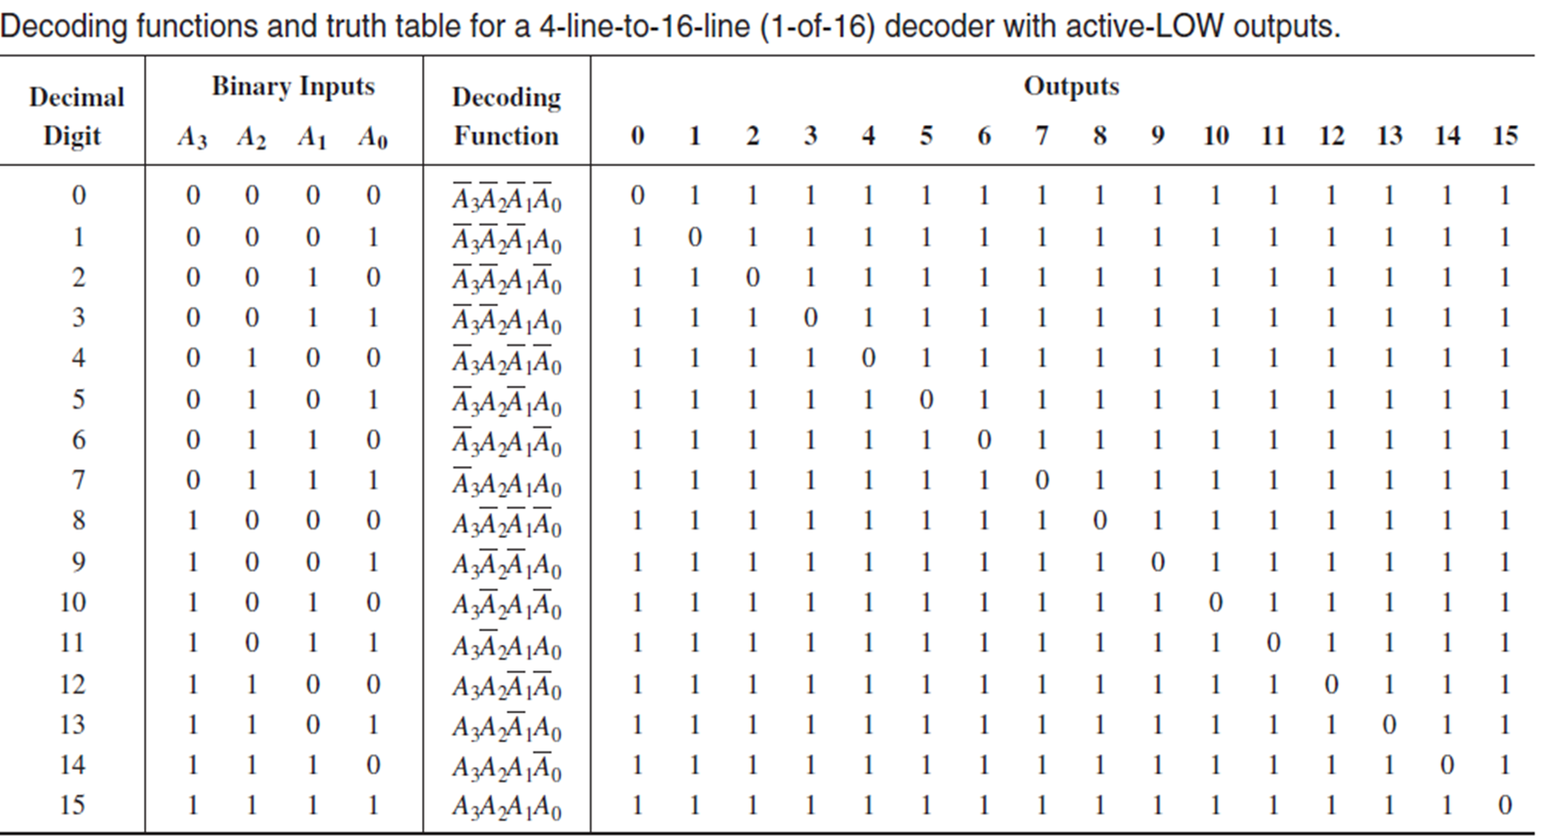
The 4-Bit Decoder

Slide 11
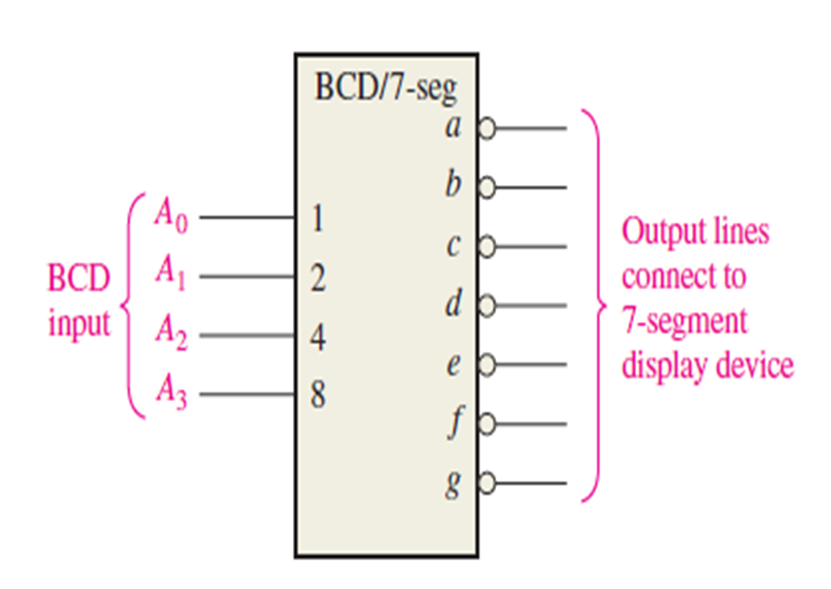
The BCD-to-7-Segment Decoder
The BCD-to-7-segment decoder accepts the BCD code on its inputs and provides outputs to drive 7-segment display devices to produce a decimal readout.
The logic diagram for a basic 7-segment decoder is shown in Figure
Logic symbol for a BCD-to-7-segment decoder

Slide 12
Encoders
An encoder is a combinational logic circuit that essentially performs a “reverse” decoder function.
An encoder accepts an inputs representing a digit, such as a decimal or octal digit, and converts it to a coded output, such as BCD or binary.
The process of converting from familiar symbols or numbers to a coded format is called encoding
Encoders can also be devised to encode various symbols and alphabetic characters.

Slide 13
The Decimal-to-BCD Encoder
This type of encoder has ten inputs—one for each decimal digit—and four outputs corresponding to the BCD code, as shown in Figure

Slide 14
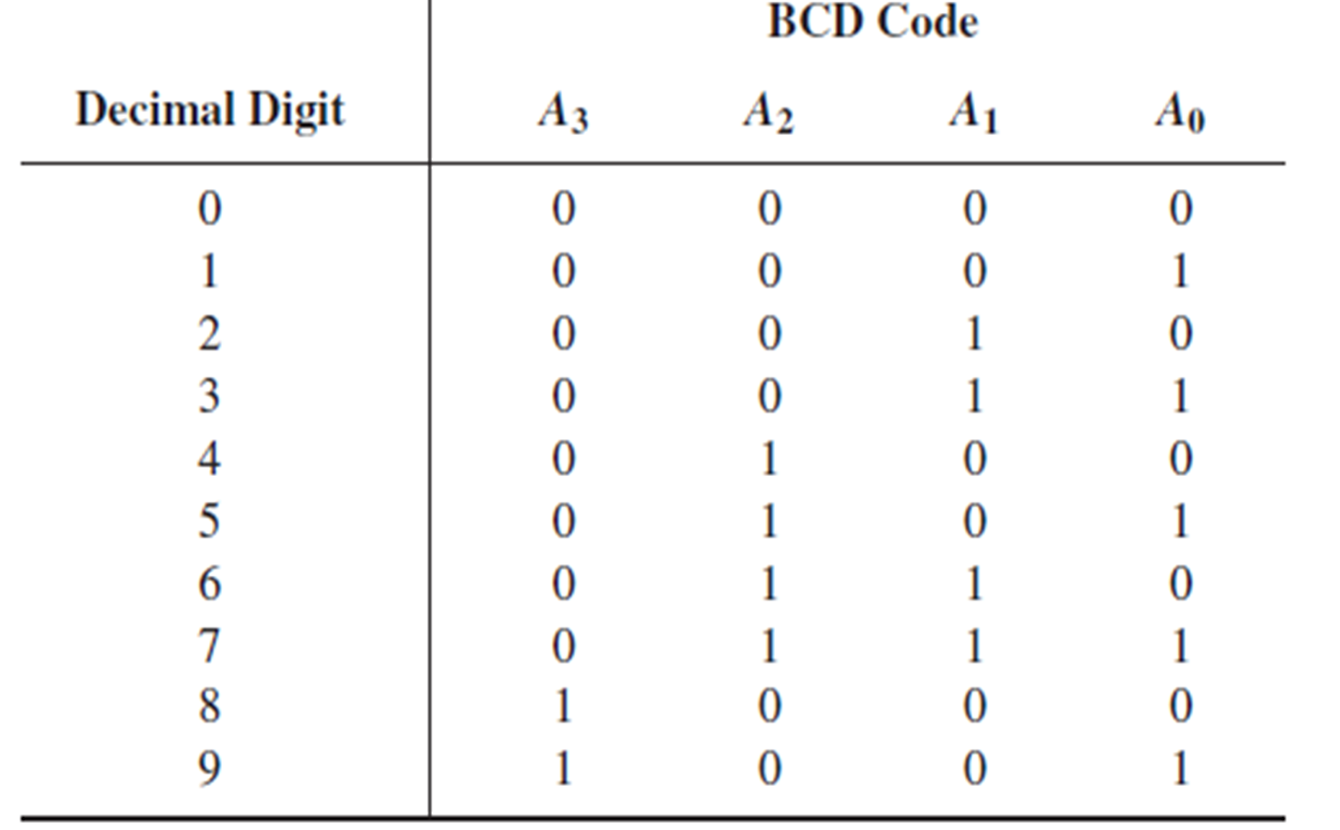
The Decimal-to-BCD Encoder

Slide 15
The Decimal-to-BCD Encoder
From table A3, is always a 1 for decimal digit 8 or 9.
An OR expression for bit A3 in terms of the decimal digits can therefore be written A3 = 8 + 9
Bit A2 is always a 1 for decimal digit 4, 5, 6 or 7 and can be expressed as an OR function as follows:
A2 = 4 + 5 + 6 + 7
Bit A1 is always a 1 for decimal digit 2, 3, 6, or 7 and can be expressed as
A1 = 2 + 3 + 6 + 7
Finally, A0 is always a 1 for decimal digit 1, 3, 5, 7, or 9. The expression for A0 is
A0 = 1 + 3 + 5 + 7 + 9
Now let’s implement the logic circuitry required for encoding each decimal digit to a BCD code by using the logic expressions just developed

Slide 16
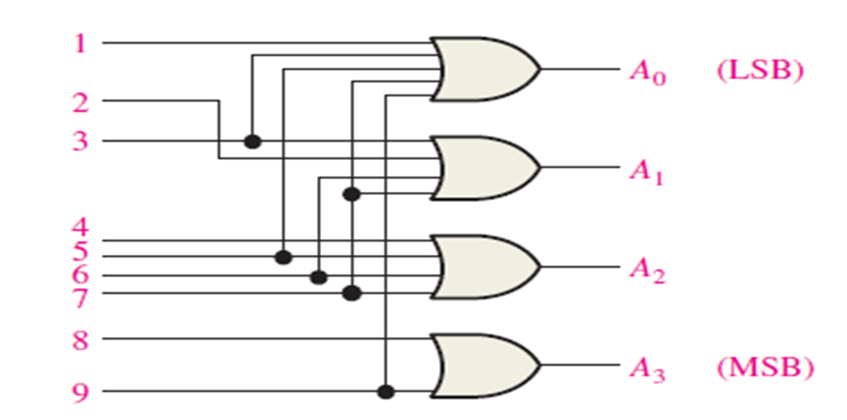
The Decimal-to-BCD Encoder

Slide 17
Multiplexers (Data Selectors)
A Multiplexer (MUX) is a device that allows digital information from several sources to be routed onto a single line for transmission over that line to a common destination.
The basic multiplexer has several data-input lines and a single output line.
It also has data-select inputs, which permit digital data on any one of the inputs to be switched to the output line.
Multiplexers are also known as data selectors

Slide 18
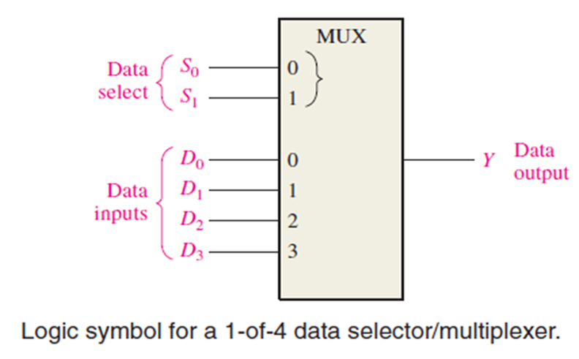
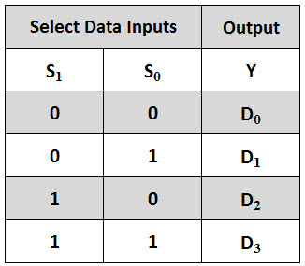

Slide 19
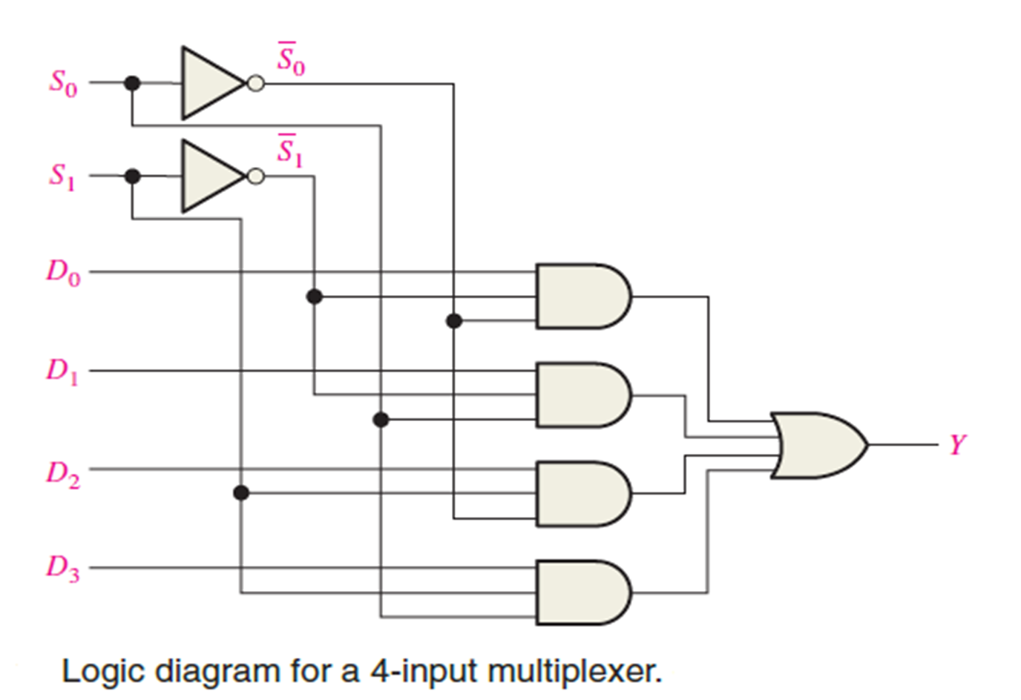
Multiplexers (Data Selectors)

Slide 20
Registers
A register is a group of flip-flops with each flip-flop capable of storing one bit of information.
They important in applications involving the storage and transfer of data in a digital system
The storage capability of a register makes it an important type of memory device.
A CPU consists of registers. Registers on modern CPUs usually store 32 bit or 64 bits.
A register is a digital circuit with two basic functions
Data storage
Data movement

Slide 21
Shift Register
A register capable of shifting its binary information in one or both directions is called a shift register
Four types of shift registers based on data input and output (inputs/outputs)
Serial In/Serial Out Shift Registers
Serial In/Parallel Out Shift Registers
Parallel In/Serial Out Shift Registers
Parallel In/Parallel Out Shift Registers

Slide 22
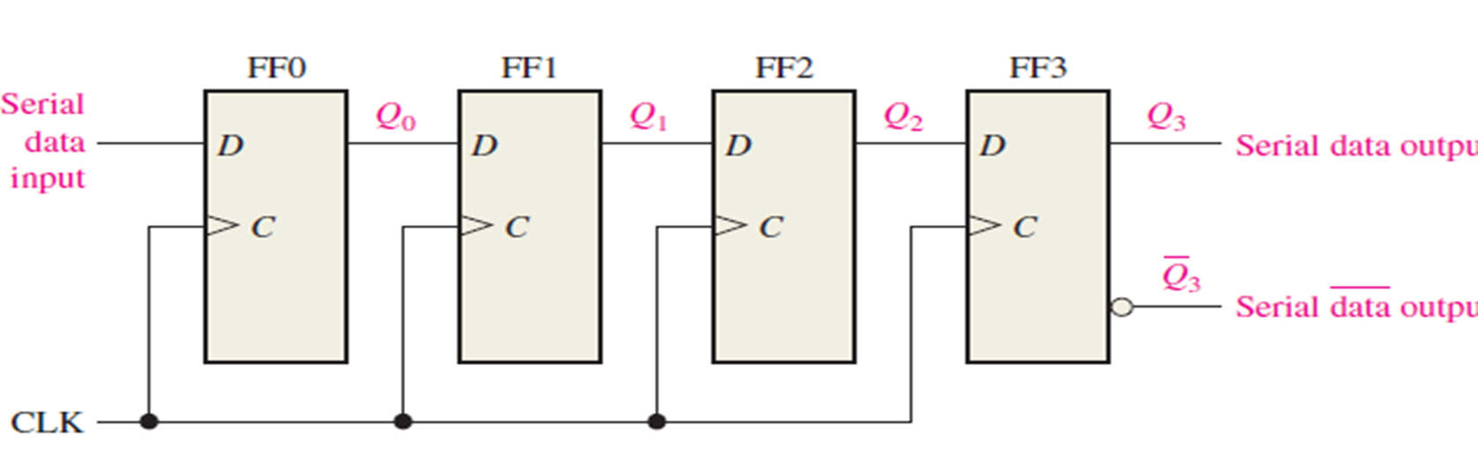
Serial In/Serial Out Shift Registers
The serial in/serial out shift register accepts data serially
one bit at a time on a single line.
It produces the stored information on its output
Figure shows a 4-bit device implemented with D flip-flops. With four stages, this register can store up to four bits of data.

Slide 23
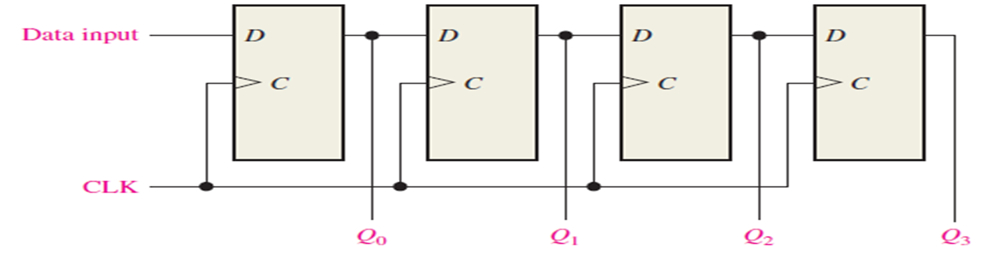
Serial In/Parallel Out Shift Registers
Data bits are entered serially (least-significant bit first) into a serial in/parallel out shift register in the same manner as in serial in/serial out registers
The difference is the way in which the data bits are taken out of the register in the parallel output register, the output of each stage is available
Once the data are stored, each bit appears on its respective output line, and all bits are available simultaneously, rather than on a bit-by-bit basis as with the serial output.

Slide 24
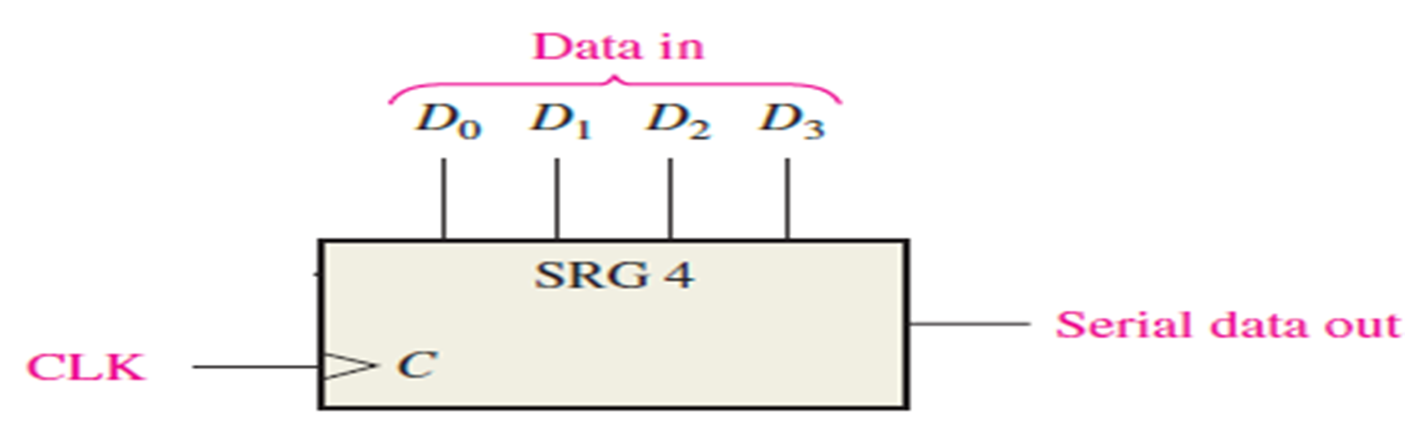
Parallel In/Serial Out Shift Registers
For a register with parallel data inputs, the bits are entered simultaneously into their respective stages on parallel lines rather than on a bit-by-bit basis on one line as with serial data inputs.
The serial output is the same as in serial in/serial out shift registers, once the data are completely stored in the register.
Figure illustrates a 4-bit parallel in/serial out shift register and a typical logic symbol.

Slide 25
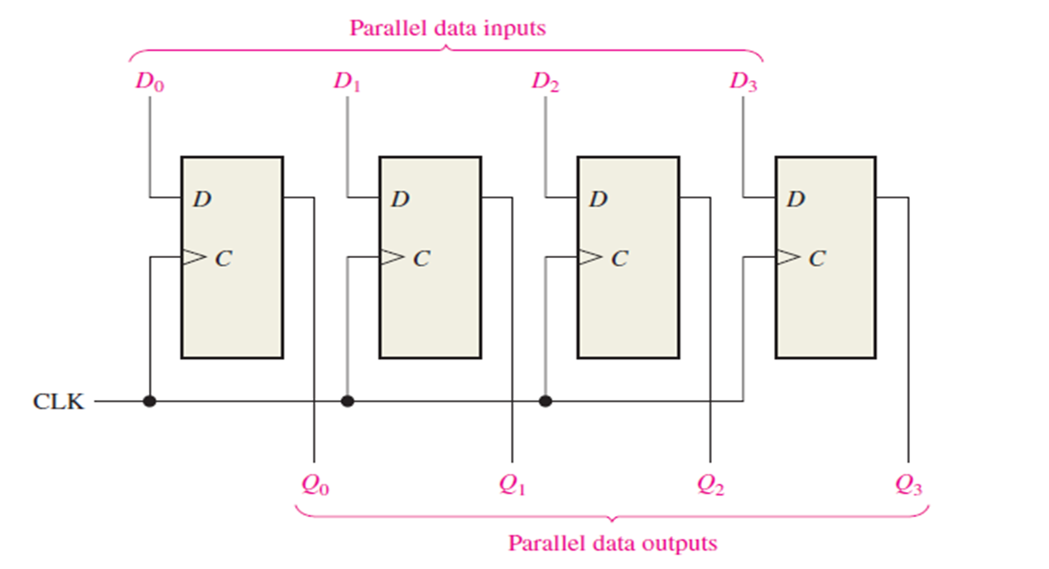
Parallel In/Parallel Out Shift Registers
The parallel in/parallel out register employs both methods. Immediately following the simultaneous entry of all data bits, the bits appear on the parallel outputs

Slide 26
Counters

Slide 27
Counters
A counter is a digital sequential logic device that will go through a certain predefined states (for example counting up or down) based on the application of the input pulses.
They are utilized in almost all computers and digital electronics systems
They are used for counting the number of occurrences of an event and are useful for generating timing signals to control the sequence of operations in digital computers two main types of counters:
Asynchronous counters
Synchronous counters.

Slide 28
Memory Unit
A memory unit is a collection of storage cells together with associated circuits needed to transfer information in and out of storage.
Memory is the part of the computer that holds data and instructions for processing.
Bit (Binary Digit)
A binary digit is logical 0 and 1 representing a passive or an active state of a component in an electric circuit.
Nibble
A group of 4 bits is called nibble.
Byte
A group of 8 bits is called byte. A byte is the smallest unit, which can represent a data item or a character.

Slide 29
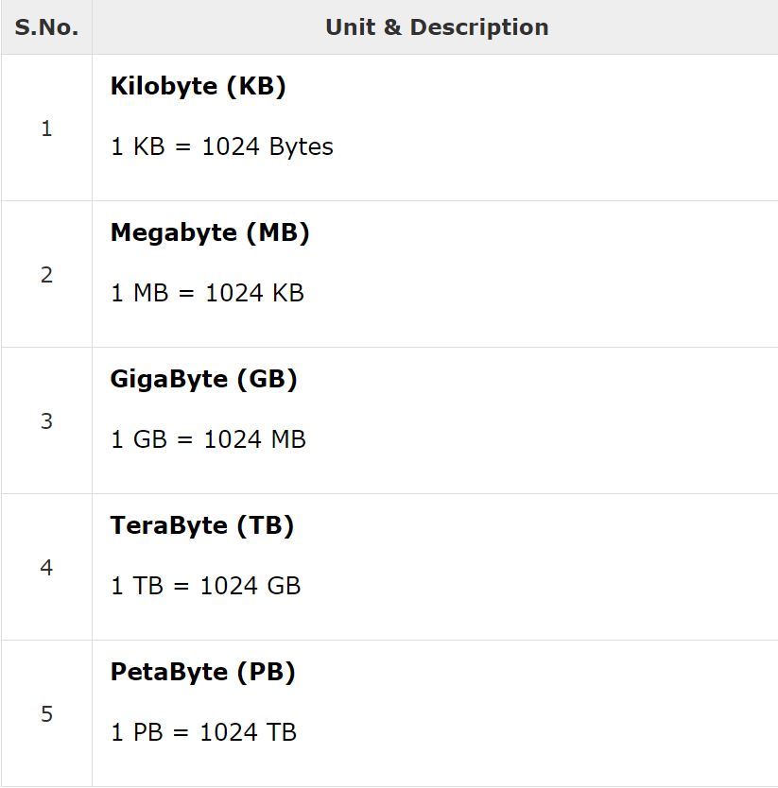

Slide 30
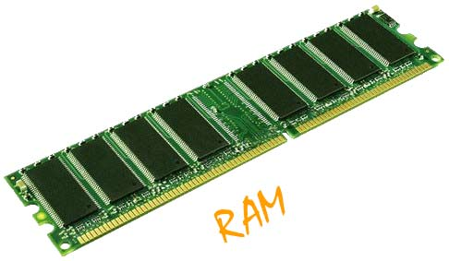
RAM Random Access memory
Alternatively referred to as main memory, primary memory, or system memory
The other distinguishing characteristic of RAM is that it is volatile. a RAM must be provided with a constant power supply. if the power is interrupted, then the data are lost. thus, RAM can be used only as temporary storage. the two traditional forms of RAMS used in computers are SRAM and DRAM.

Slide 31
DRAM and SRAM
DRAM stands for dynamic random access memory.
It is a type of semiconductor memory in which the memory is stored in the form of a charge. each memory cell in a dram is made of a transistor and a capacitor. the data is stored in the capacitor. capacitors loose charge due to leakage and hence dram's are volatile devices.
In contrast, a Static RAM (SRAM) is a digital device that uses the same logic elements used in the processor. In a SRAM, binary values are stored using traditional flip-flop logic-gate configurations
A static RAM will hold its data as long as power is supplied to it.

Slide 32
Assignment
DRAM Vs SRAM

Slide 33
read-only memory (ROM)
Contains a permanent pattern of data that cannot be changed.
A ROM is nonvolatile; that is, no power source is required to maintain the bit values in memory
If you ever do the hardware setup procedure with your computer, you effectively will be writing to ROM.
Another example of ROM is
PROM
EPROM
EEPROM

Slide 34
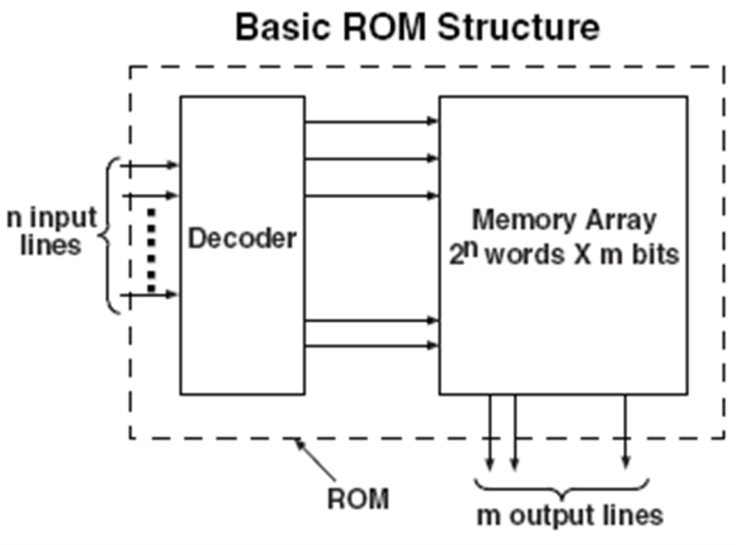

Slide 35
PROM
Developers created a type of rom known as programmable read-only memory (prom).
Blank prom chips can be bought inexpensively and coded by the user with a programmer.
PROMs retain their contents when the computer is turned off. The difference between a PROM and a ROM (read-only memory) is that a PROM is manufactured as blank memory, whereas a ROM is programmed during the manufacturing process.

Slide 36
EPROM
Acronym for erasable programmable read-only memory, and pronounced ee-prom, eprom is a special type of memory that retains its contents until it is exposed to ultraviolet light.
The ultraviolet light clears its contents, making it possible to reprogram the memory. to write to and erase an eprom, you need a special device called a prom programmer or prom burner
To rewrite an eprom, you must erase it first. to erase it, you must supply a level of energy strong enough to break through the negative electrons blocking the floating gate. in a standard eprom, this is best accomplished with UV light at a wavelength of 253.7 nanometers (2537 angstroms). because this particular frequency will not penetrate most plastics or glasses, each eprom chip has a quartz window on top of it. the eprom must be very close to the eraser's light source, within an inch or two, to work properly.

Slide 37
eeprom
eeprom- it stands for electrically erasable read only memory. these are also erasable like eprom, but the same work of erasing is performed with electric current. thus, it provides the ease of erasing it even if the memory is positioned in the computer. it stores computer system’s bios.
EEPROM chip has to be erased and reprogrammed in its entirety, not selectively
A special form of EEPROM is flash memory, which uses normal PC voltages for erasure and reprogramming.

Slide 38
Thank you

